Slide 1
Semester Project
Ibrahim ounon
Professor: Benoit Garbinato
Assistant: Melike GECER

Slide 2
Summary
Context
Planning
Technologies
Approach
Structure
Database
Code demonstration
Conclusion

Slide 3
Context
Problem
Impossible to check students solution one by one.
The JupyterHub solution is not optimal.
Solution to be implemented
developing an online coding environment.

Slide 4
Planning
Backend
01.10.2020 – 30.11.2020
Frontend
01.12.2020 – End January

Slide 5





Technologies
Spring Boot
Tomcat
JSF (Primeface)
Jdoodle
MySQL

Slide 6
Approach
Microservices approach
Two microservices
Management of users
Management of exercises

Slide 7
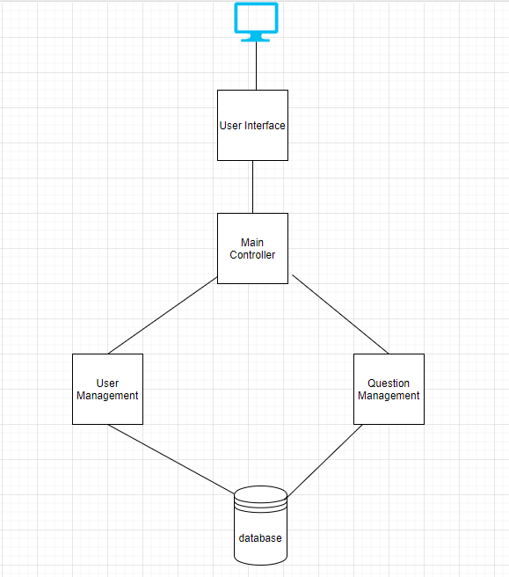
Structure

Slide 8
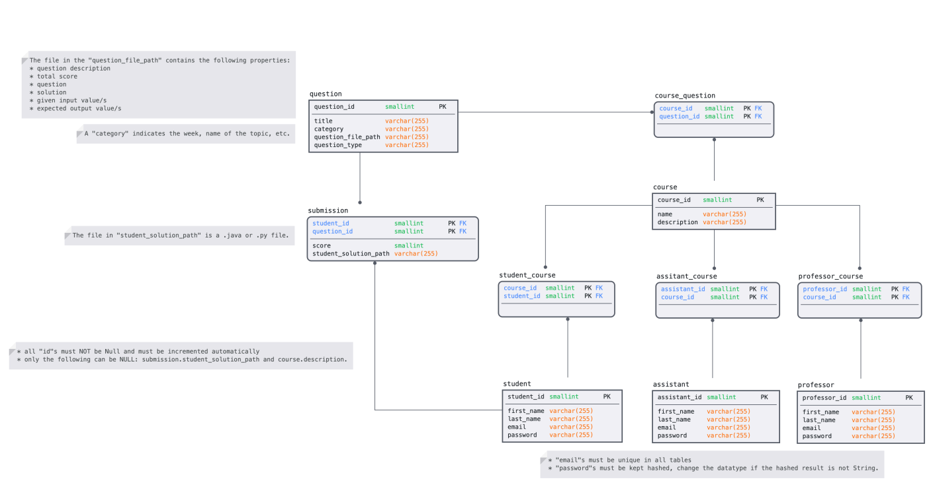
Database

Slide 9
Code Structure and Demonstration
Packages
Entities
DAO
Services

Slide 10
Conclusion (1/2)
Microservice User
Can create, update and delete students, assistants and professors.
Can add courses.
Microservice Question
Can create, update and delete courses.
Can add questions.
Can create, update and delete questions.

Slide 11
Conclusion (2/2)
Microservice User
Cannot delete many to many relashionship.
Not possibility to update one field.
Microservice Question
Do no create the submission properly.
Not possibility to update one field.

Slide 12


